Slide 1


Movie Time!!!!

Slide 2
GLOBAL NATURAL DISASTER IMPACT 1976-2024
Hameeda Ebrahim – DAB 16

Slide 3
Agenda
01
02
03
FLOODS ANALYSIS
STORMS ANALYSIS
OVERVIEW
04
05
06
EARTHQUAKES ANALYSIS
REGIONS & RESPONSE ANALYSIS
RECOMMENDATIONS

Slide 4
—PROBLEM STATEMENT
“From 1976 until 2024, The number of people affected per disaster shows a clear seasonal pattern, peaking sharply in Summer and Autumn months. This indicates that disasters occurring in these seasonal months tend to have significantly higher human impact”.

Slide 5
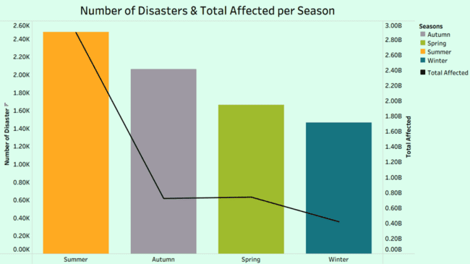

Slide 6
APPROACHES
1
2
3
4
5
Most Disasters
Seasonlity vs. Disasters
Risk index
Magnitude & Tectonic Plates
Regions
vs. Response

Slide 7
Risk index
Total Deaths
Total Affected
Frequency

Slide 8
01
OVERVIEW

Slide 9
Data Statistic
Total Number of Disasters | +12K
Number of Types of Disasters | 29
Natural 12
Technological 17

Slide 10
NATURAL VS TECNILOGICAL
NATURAL DISASTERS
TECHNOLOGICAL DISASTERS
“Environmental phenomena”.
“Human activities, system failures, and industrial processes”.

Slide 11
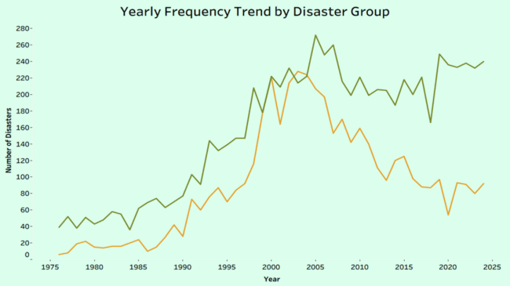
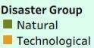
Notes:
Natural disasters increased over time Technological disasters increased, then sharply declined
Natural hazards continue to dominate global disaster frequency in recent years.
The increase in natural disasters may reflect improved reporting and population exposure, while the decline in technological events may be linked to stricter safety regulations and better risk management.

Slide 12
NATURAL DISASTERS

Slide 13
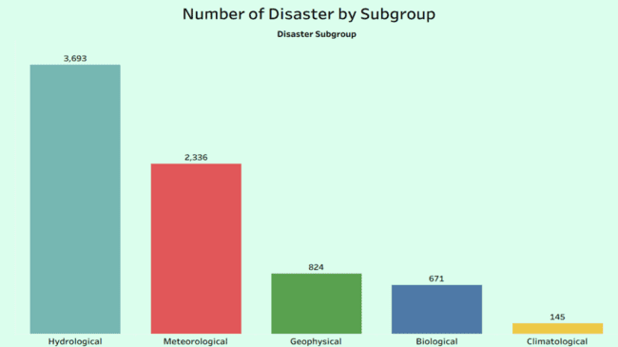
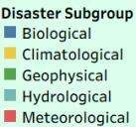

Slide 14
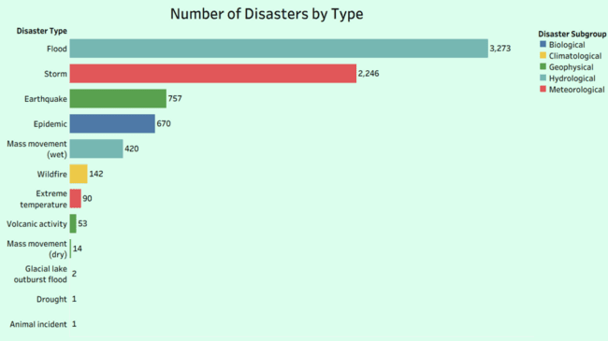

Slide 15
Top 3 Disasters:
STORMS
“Meteorological”
FLOODS
EARTHQUAKES
“Hydrological”
“Geophysical”

Slide 16
02
FLOODS DISASTERS

Slide 17
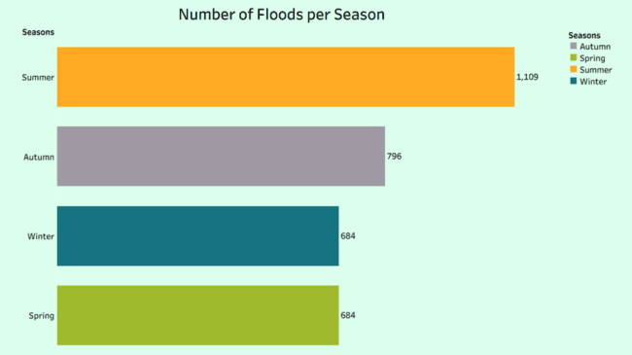

Slide 18





Why Mostly in “Summer” ?

Slide 19
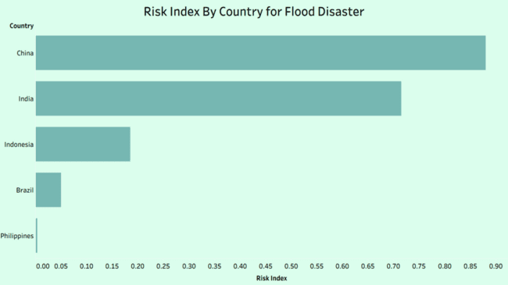

Slide 20





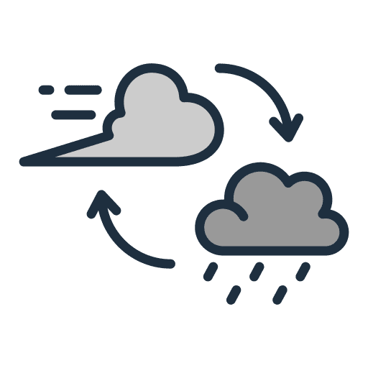

Why “China” Has a High Risk Index?

Slide 21
03
STORM DISASTERS

Slide 22
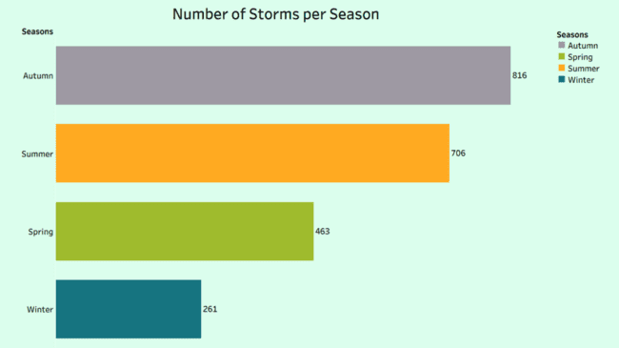

Slide 23
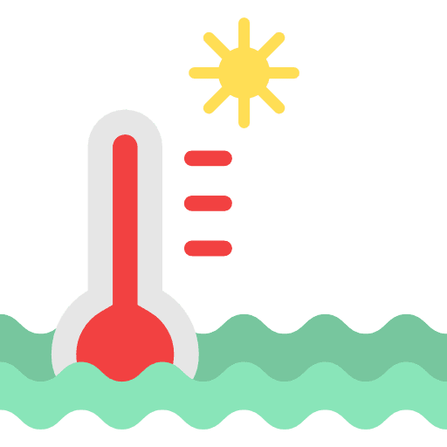



Why Mostly in “Autumn”?
Warm ocean water
Low wind shear
Tropical atmosphere
Atmospheric spin

Slide 24
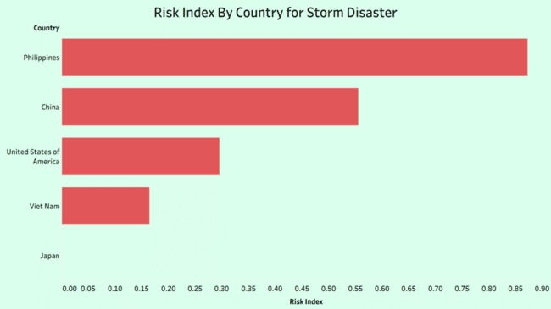

Slide 25

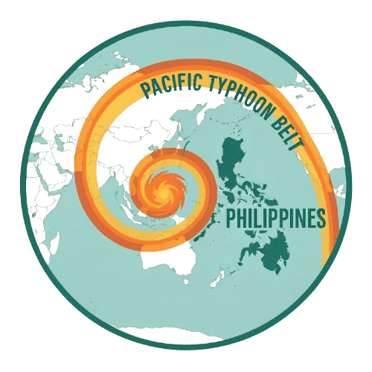


Why “Philippinse” Has a High Risk index?
Extreme Weather
Pacific Typhoon Belt

Slide 26
04
EARTHQUAKE DISASTERS

Slide 27
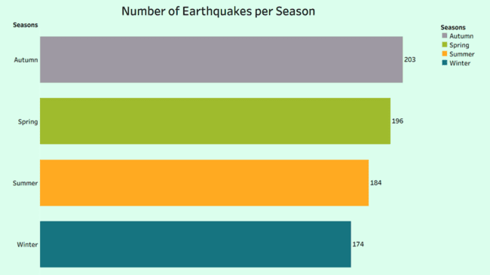

Slide 28
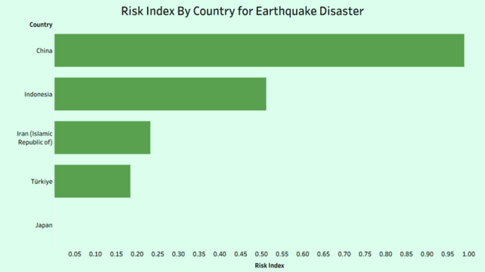

Slide 29
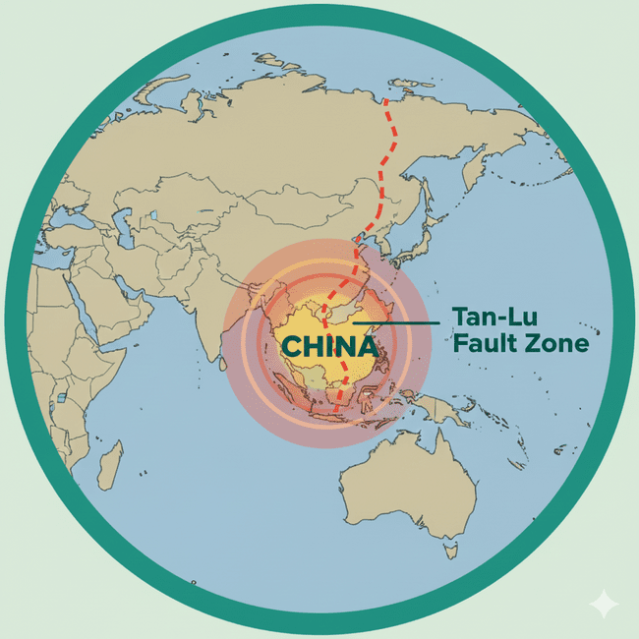
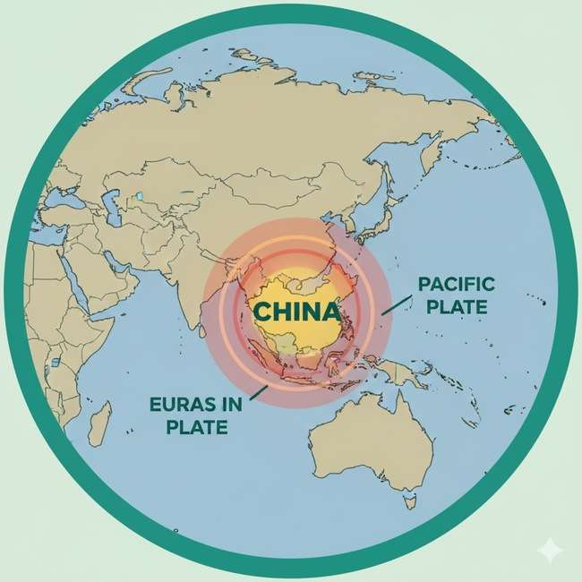

Why “China” Has a High Risk Index?
Mountainous Terrain
Tan-Lu Fault Zone
Plate Intersection

Slide 30
Earthquakes Magnitude Classification
Classification Description | Magnitude Range
Micro | 1.0-1.9
Minor | 2.0-2.9
Slight | 3.0-3.9
Light | 4.0-4.9
Moderate | 5.0-5.9
Classification Description | Magnitude Range
Strong | 6.0-6.9
Major | 7.0-7.9
Great | 8.0-8.9
Extreme | 9.0-9.9

Slide 31
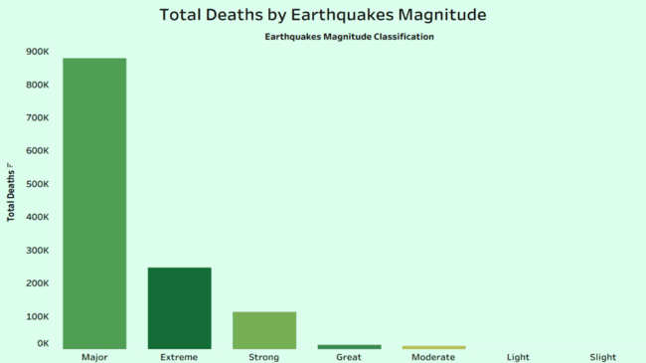
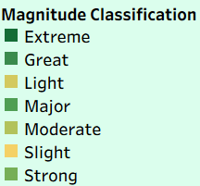

Slide 32
Earthquakes Magnitude Classification
Classification Description | Magnitude Range | Frequency | Total Deaths
Major | 7.0-7.9 | 161 | 877.89k
Extreme | 9.0-9.9 | 11 | 246.24k
Strong | 6.0-6.9 | 307 | 112.92k
Great | 8.0-8.9 | 20 | 12.50k
Moderate | 5.0-5.9 | 223 | 10.24k

Slide 33
Earthquakes Magnitude Classification
Classification Description | Magnitude Range | Frequency | Total Deaths
Major | 7.0-7.9 | 161 | 877.89k
Extreme | 9.0-9.9 | 11 | 246.24k
Strong | 6.0-6.9 | 307 | 112.92k
Great | 8.0-8.9 | 20 | 12.50k
Moderate | 5.0-5.9 | 223 | 10.24k

Slide 34
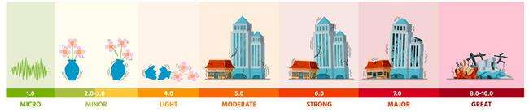
“Major” vs. “Strong” Magnitude:
Magnitude +1
32 Times Energy
Energy
Greater Destruction & Deaths

Slide 35
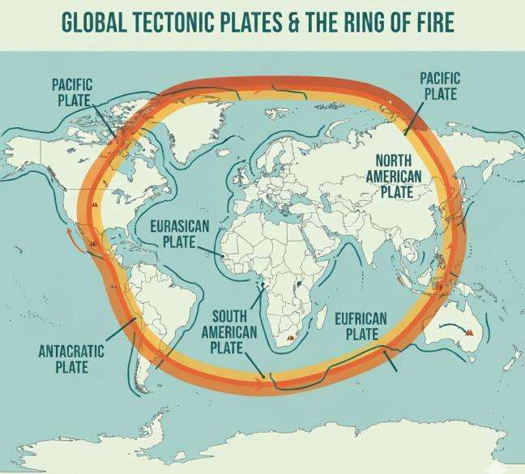

Slide 36
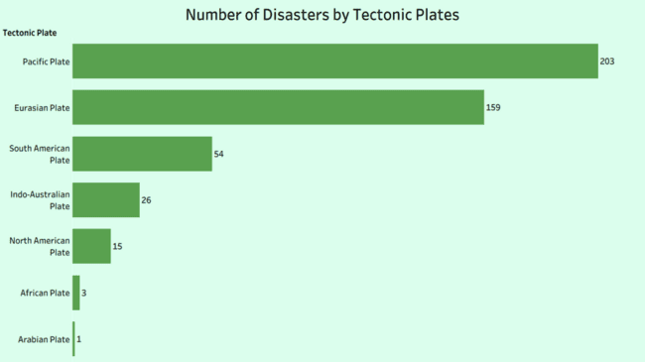

Slide 37
Why “Tectonic Plate”?
Subduction Zones
Active Plate Boundaries
Transform Boundaries
Divergent Boundaries

Slide 38

05
Regions & Response

Slide 39


Response
Appeal
OFD /BHA Response
A request for international assistance.
Office of US Foreign Disaster Assistance (OFDA) or the Bureau of Humanitarian Assistance (BHA) responded to the disaster.

Slide 40
Response Efficiency Type
Bad Response
Partial Response
Good Response
0
1
2

Slide 41
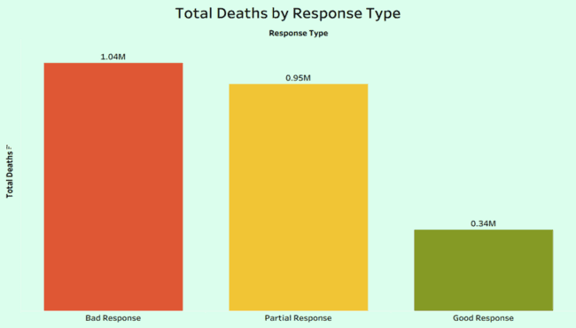
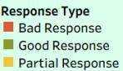

Slide 42
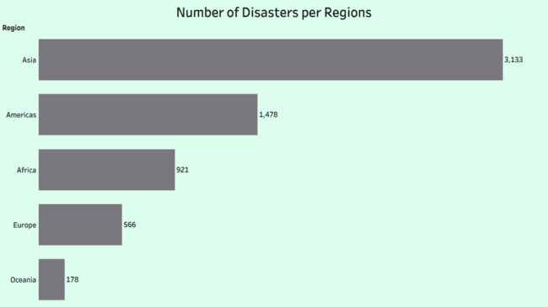

Slide 43
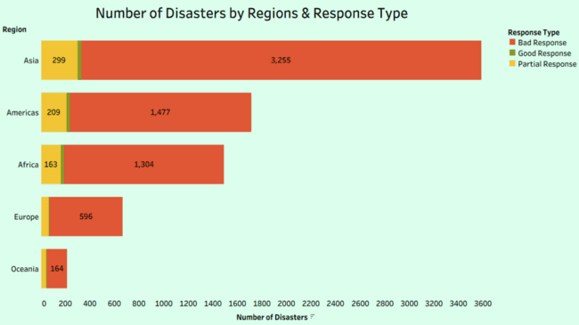

Slide 44



Why Asia?
High Population
Economic Constraints
Weak Infrastructure

Slide 45
Recommendations

Slide 46
Recommendations:
Early Warning
Seasonal Forecasting
Community Training
Seismic Buildings
Better Response Coordination
Capacity Building for Local Responders

Slide 47
TKANK YOU FOR LISINING!!!

